Slide 1
Postsecondary Electronics Standards Council
Common Identity and Trust (CommIT) Collaborative Pilot Project

Slide 2
PESC
Through open and transparent community participation, PESC enables cost-effective connectivity between data systems to accelerate performance and service, to simplify data access and research, and to improve data quality along the higher education lifecycle.
http://www.pesc.org/

Slide 3
PESC Information
73 Members and Affiliates and 7 major partners
Formal policies and procedures for the standards development process
Defined XML Data Architecture and Schema Guidelines
Seal of Approval Program – Optional service to ensure uniformity of implementation
XML Registry & Repository for the Education Community – Provides common repository for Education Data definitions in XML. (Will be Replaced by NIEM)
EdUnify - a shared, neutral community directory for registration of Web services and governance framework for service-oriented architecture

Slide 4
PESC Standards Development
9 Standards Approved – High School Transcript, College Transcript, Common Origination & Disbursement (COD), Common Record: CommonLine (CRC), Data Transport Standard (DTS), Online Loan Counseling, Admission Application, IPEDS, Education Test Score Reporting
5 Standards in Development – Academic e-Portfolio, Academic Progress, CourseInventory, PDF Transcript, Recruitment & Enrollment
2 User Group – Education Record User Group for all transcript standards, Canadian User Groups for specific Canadian information.
4 Task Forces – E-Authentication/E-Authorization Task Force (EA2), EdUnify Task Force, Common Data Services Task Force, Social Media & Networking Task Force

Slide 5
PESC Membership
AcademyOne, Inc. Accenture ACE ACT* Avow Systems, Inc. Board of Regents, Georgia University System California Community Colleges California School Information Services Central Connecticut State University Clayton State University College Board* College Source, Inc. Common Application Community College of the Air Force ConnectEdu, Inc. Datatel Decision Academic Docufide Educause* Edustructures/Pearson ELM Resources Emory University eScholar Florida International University Florida State University George Washington University Georgetown University IMS Global Learning Consortium | Indiana State University Iowa State University Jenzabar Kaplan University Key Bank Kuali Foundation Leepfrog LSAC* NASLA National Student Clearinghouse NCHELP* NELA Nelnet Ohio Board of Regents Ontario College Application Services Oregon State University, Corvallis Oracle PA College of Technology Purdue University redLantern SCRIP-SAFE International San Francisco State University SIF Association Simon Fraser University SmartCatalog Southern Connecticut State University Stanford University SunGard Higher Education* | Texas A&M University TG University of California, Berkeley University of Denver University of Idaho University of Illinois at Chicago University of Illinois University of Lethbridge University of Louisiana at Lafayette University of Minnesota University of Mississippi University of North Carolina, Greensboro University of Northern Iowa University of Oklahoma University of Oregon University of Phoenix University of South Florida University of Texas at Austin University of Virginia US Department of Education* US General Services Administration USA Funds* Washington State University XAP Corporation *Founding member

Slide 6
PESC Partners
AACRAO’s SPEEDE Committee – American Association of Collegiate Registrars and Admissions Officers, Standardization of Postsecondary Education Electronic Data Exchange
DQC – Data Quality Campaign
InCommon Federation
SHEEO – State Higher Education Executive Officers
SIF Association
US Department of Education
  NCES – National Center for Education Statistics
  FSA – Office of Federal Student Aid
  Office of the Under Secretary

Slide 7
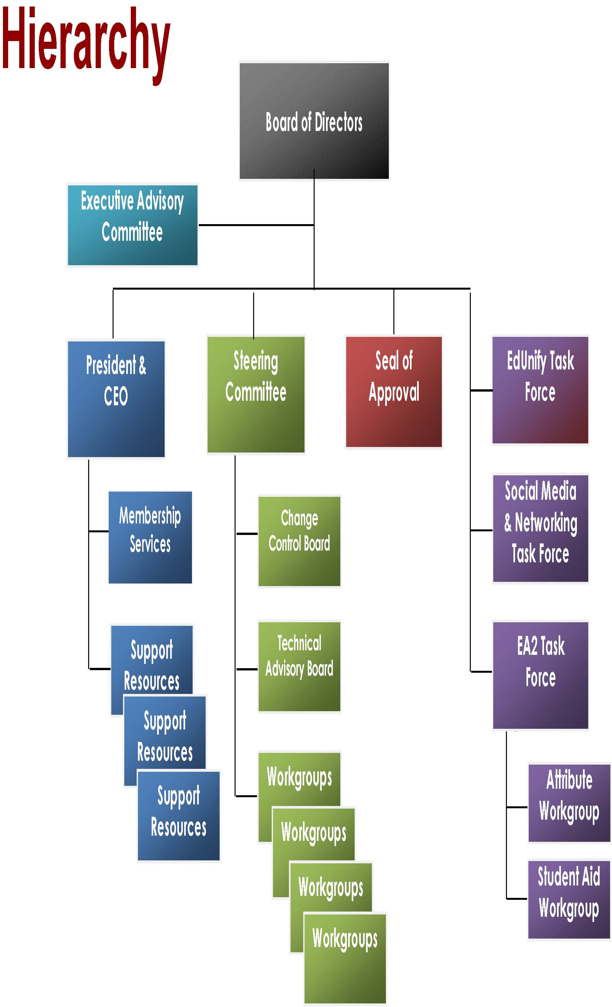
PESC Organization

Slide 8
InCommon Federation
217 Colleges and Universities
11 Government and Non-Profit Organizations
75 Education Vendors
http://www.incommon.org/participants/

Slide 9
InCommon Technology
Based on SAML compliant Shibboleth® federation software
Shibboleth® was developed as an open source project managed by internet2.
Uses internet2 EduPerson and EduOrg LDAP schemas for attribute collection and assertion
Provides single sign-on using an identity provider to authenticate users
Protects personal identity by only releasing the minimal attributes required to access a service from a service provider

Slide 10
Advantages of Identity and Access Federation
Single point of sign-on to access multiple services from different providers
Fewer accounts for service provider to manage since authentication is done at the identity provider
Fine grained control of the release of identity information
Rapid integration of new services
Simplification of user maintenance of logons and passwords

Slide 11
Internet2
Internet2 members are focused on developing and deploying advanced networking technologies and capabilities in service of U.S. research and higher education.
Internet2 is a not-for-profit consortium comprised of:
  221 U.S. universities
  45 leading corporations
  71 government agencies, laboratories and other institutions of higher learning
  38 regional and state research and education networks

Slide 12
Internet2
Internet2 members leverage a high-performance network, enabling services and worldwide partnerships to support and enhance educational, research, and community service missions.
Internet2 actively engages the community in the development of important new technologies:
  Middleware
  Security
  network research
  performance measurement capabilities which are critical to the forward progress of Internet applications
Internet2 provides a security certificate service to members

Slide 13
Common Identity and Trust (CommIT) Collaborative
Potential College applicants would use a single sign-on for access to ACT, College Board, Free Application for Federal Student Aid, Common Application, National Transcript Center, National Student Clearinghouse, and higher education institutions.
A third party identity provider would create accounts and maintain an identity store using a minimal number of attributes that are sufficient for matching.
The organizations that can match an applicant and the applicant’s identifier to proof documents would add that proofing information to the identity store (e.g., InCommon Bronze and Silver Profile).

Slide 14
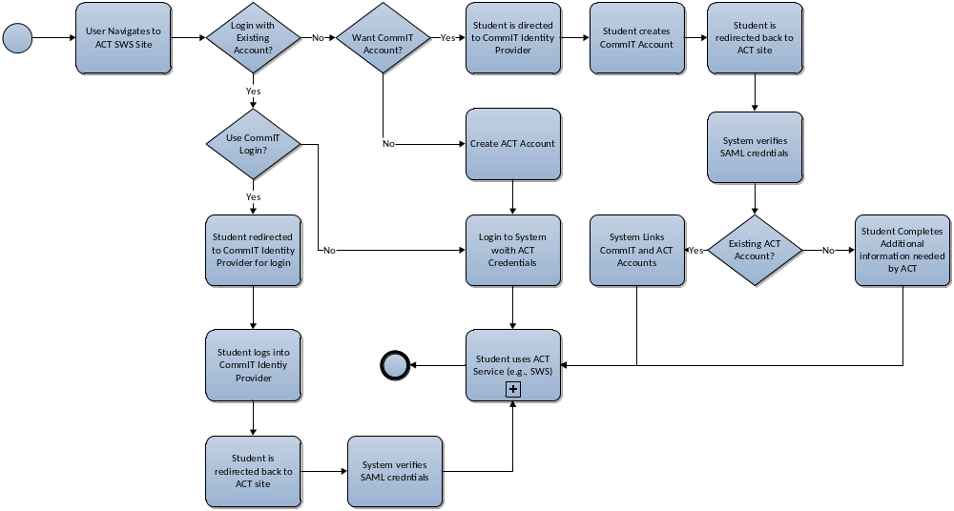
CommIT Implementation

Slide 15
Advantages to Student
Common log-on to track all application and admission information
Single ID to aggregate a portfolio of transcripts, scores, applications, and student aid information
Reduced delays in processing due to easier matching of student to information by colleges

Slide 16
Advantages to Colleges and Universities
Faster and less error prone aggregation of application credentials by using a common ID
Assurance that student is associated with valid credentials
Just in time pull of student credentials from multiple service providers
No need to provision user IDs and passwords to applicants

Slide 17
Advantages to Vendors
No need to provision IDs and passwords for students
Gain identity proofing from multiple organizations
Provide self service of information by colleges from vendors (pull model)

Slide 18
Cost and Revenue Advantages to ACT
Reduced provisioning of IDs and passwords
Ability to use other members proofing
Provide self service of information requests from educational institutions
Obtain increased revenue for additional score reports
Receive new revenue for identity proofing

Slide 19
Other Advantages to ACT
Develop strategic relationships with internet2 and InCommon
Associate ACT brand with innovative initiative
Develop technology skills in federated identity management
Be able to aggregate research data between ACT, universities, and intermediaries (e.g., National Student Clearinghouse, Common App, FSA)

Slide 20
ACT Potential Future Uses
Match K-8 data to other data sets tied to CommIT ID after matching
Create cross organization privacy preserving data aggregation research network
Extend CommIT ID to workforce so that predictive research using non-ACT data may be accomplished
Use identity proofing for CommIT ID from other organizations to improve security

Slide 21
ACT Participation In Pilot
Pilot funded by internet2
Includes identity provider implementation for single sign-on
Need example service providers to demonstrate how the system will work
Proposal: Add federated logon to Student Web Services
https://spaces.internet2.edu/display/InCAdmissions/Home

Slide 22
Participation Questions
Will identity proofing and reduced credential maintenance provide sufficient revenue to justify participation?
Are the branding opportunities sufficient to drive participation?
Do we want to be an InCommon service provider independent of any student identity scheme?

